Slide 1
COS 212 Self-Organizing Lists, Sparse Tables

Slide 2
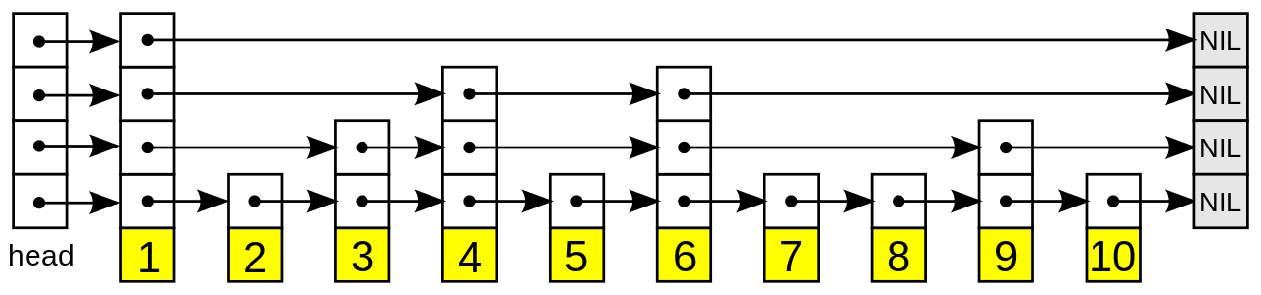
Improving the Linked Lists
Skip lists are ordered linked lists that enable efficient search
The linkage in a skip list is rather complicated
Maintaining the skip list is also complex
Can’t we improve the efficiency of ordinary one-layered linked lists instead?

Slide 3
Self-Organizing Lists
Self-organizing lists are linked lists that reorganize data order to improve search efficiency
An ordered list is a self-organizing list
Every data element is inserted in a correct place to preserve the order of elements
Searching an ordered list is more efficient than searching an unordered list
Why?
Suppose you are looking for D
B
E
A
F
A
B
E
F
Unordered
Ordered

Slide 4
Self-Organizing Lists
Move‑to‑front method:
Locate the desired element
Put the desired element’s node at the beginning of the list
Why does this work?
Because the elements that are accessed more often than others will eventually all move to the front
The most-used elements are now easily accessible
Drawbacks?
A
B
C
D
Access
C
C
A
B
D

Slide 5
Self-Organizing Lists
Transpose method:
Locate the desired element
Swap desired element’s node with predecessor (unless it’s the head)
Why does this work?
Same reason as move-to-front: the elements that are accessed more often than others will move closer and closer to the front
This approach is more cautious than move-to-front
Drawbacks?
A
B
C
D
Access
C
A
C
B
D

Slide 6
Self-Organizing Lists
Count method:
Maintain list order according to access count for each element
Locate the desired element, and update its access count
If necessary, move the desired element
Why does this work?
Access frequencies explicitly tell us which elements are accessed the most
Elements with a higher probability of being accessed are always in front of the elements with a lower probability
Drawbacks?
A
4
B
2
C
2
D
2
Access
D
A
4
D
3
B
2
C
2

Slide 7
Adding Elements to the List
Move-to-front, transpose, and count methods:
A
B
X
Y
P
A
B
X
Y
P
Ordering method:
A
B
X
Y
P
A
B
P
X
Y

Slide 8
Self-Organizing Lists
So many methods, so little time…
Ordering (based on some natural data property)
Move-to-front
Transpose
Count (keep track of usage frequencies)
Which one is the most efficient of them all?
Asymptotic complexity focuses on operations in isolation, but true efficiency here depends on order of insertions and access
We will therefore analyse efficiency by means of sample runs on text files containing English words
A sample run denoted 189/362 means 189 unique words appeared in a document containing 362 words
Compare self-organizing lists to a skip list, optimal static ordering (data is already ordered by frequency), and a plain linked list
Element comparisons as percentage of maximum possible comparisons (i.e. assume all elements are compared at every step)

Slide 9
Self-Organizing Lists
Element comparisons as percentage of maximum possible comparisons
Different words/All words | 189/362 | 1448/7349 | 3049/12948 | 6835/93087
Optimal (pre-ordered) | 29.7 | 15.3 | 15.5 | 7.6
Plain | 66.1 | 48.8 | 43.4 | 19.3
Move-to-Front | 58.2 | 29.7 | 35.7 | 14.3
Transpose | 78.6 | 39.6 | 43.0 | 18.2
Count | 57.1 | 30.2 | 35.9 | 13.4
Alphabetical Order | 55.3 | 50.2 | 53.8 | 54.9
Skip List | 11.1 | 4.8 | 4.3 | 3.6

Slide 10
Self-Organizing Lists

Slide 11
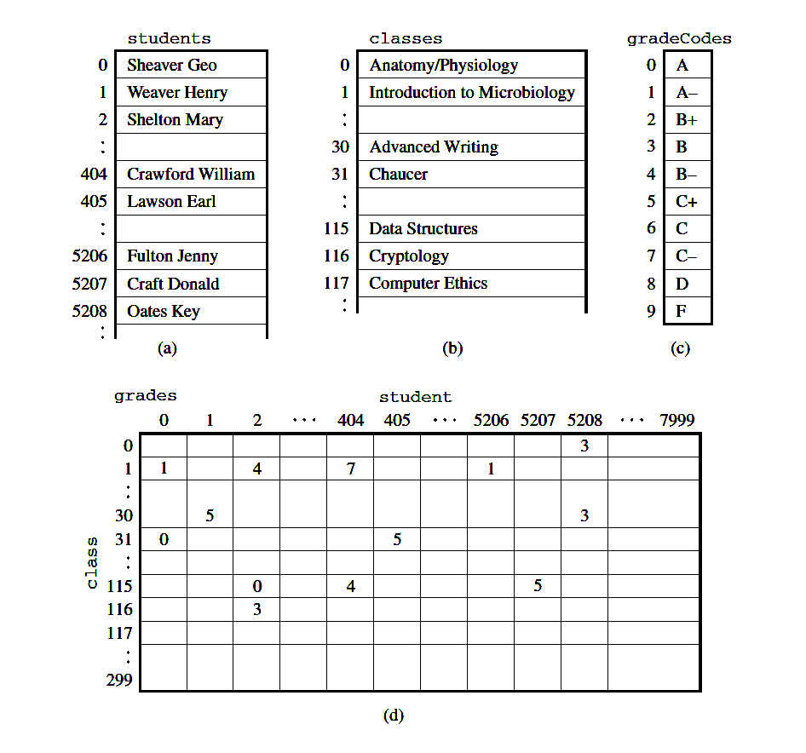
Sparse Tables
Storing data in a table rather than a vector is often natural/desirable
It is also often wasteful, especially if the table has a lot of empty cells
A poorly populated table is referred to as a sparse table
How can we make such a structure efficient?

Slide 12
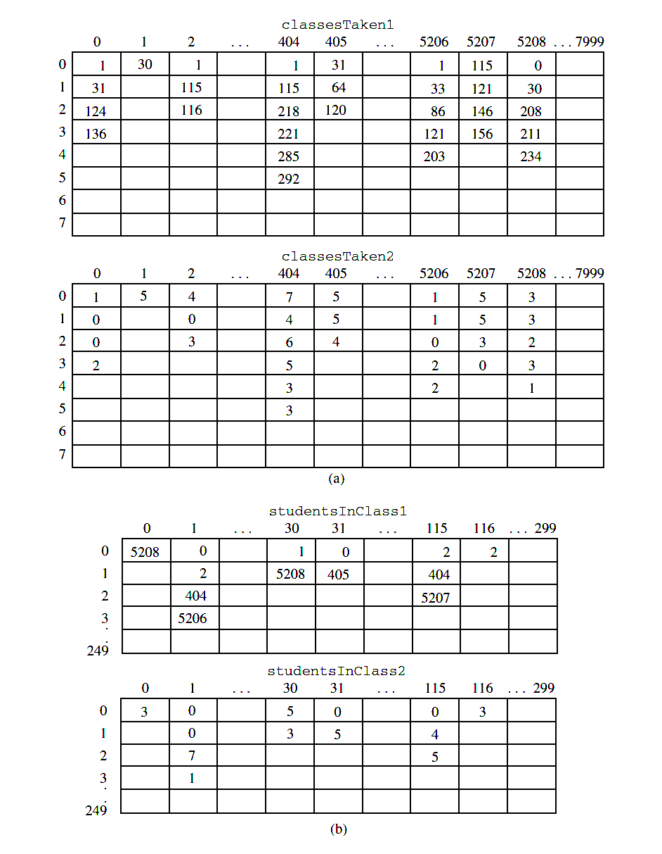
Sparse Tables: Crazy Solution
Subject codes
Assume every student can take max 8 classes
Assume each class can have max 250 students
Create 4 tables!
2 to store subject codes p/student, and grades p/student/class
2 to store students p/class, and grades p/class/student
Less wasteful, but still wasteful (why?)
Very inflexible (why?)
Grade codes
Student numbers
Grade codes

Slide 13
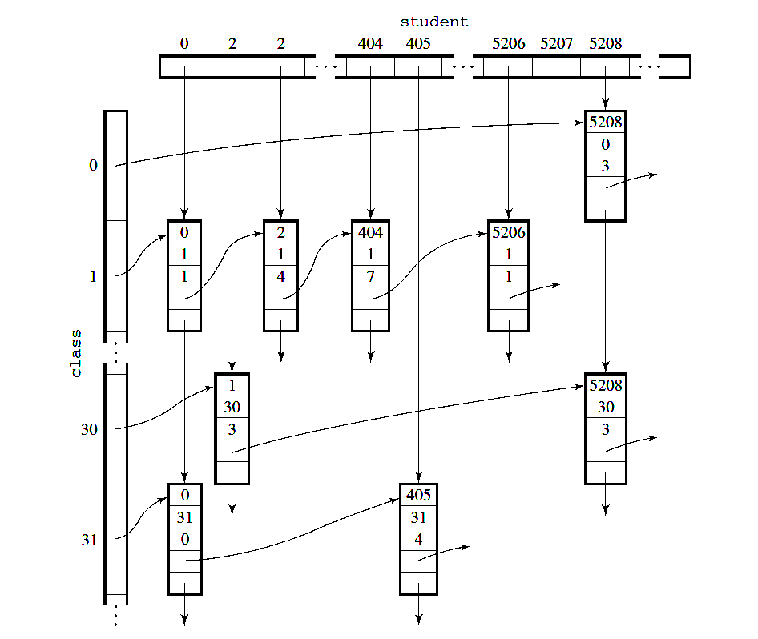
Sparse Tables: Elegant Solution
a linked lists of classes taken by a student starts here
Arrays of linked lists
1
a linked list of students taking a class starts here
Student number
Pointer to next student
Class code
Pointer to next class
Grade
No space is wasted
No duplicates
Fast and flexible

